Slide 1
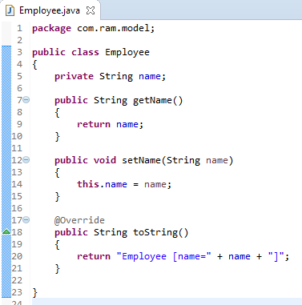
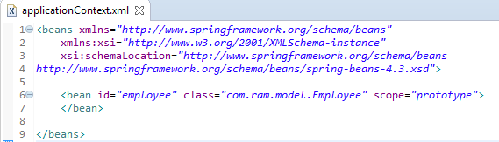
Prototype Scope
If we want a new ‘employee’ bean instance, every time you call it, use prototype scope.

Slide 2
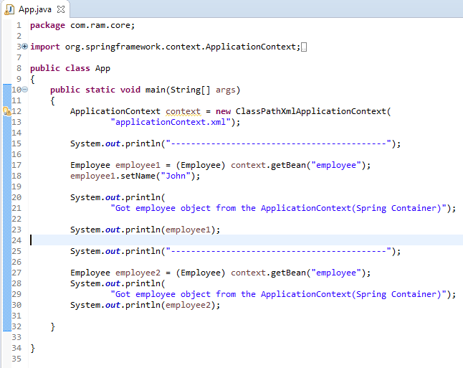
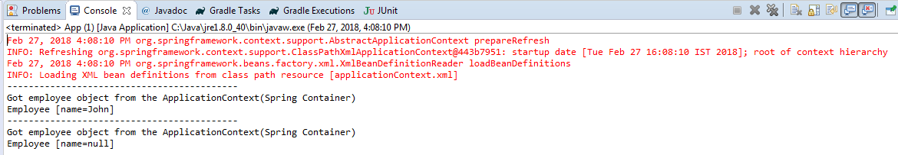
Prototype Scope
In prototype scope, we will have a new instance for each getBean() method called.
Spring Container
employee1
employee2
Two getBean() calls,
so two instance are created

